Slide 1

CHAPTER 4
ELEMENTARY
NUMBER THEORY
AND METHODS
OF PROOF
Copyright © Cengage Learning. All rights reserved.

Slide 2
SECTION 4.6
Indirect Argument: Contradiction
and Contraposition
Copyright © Cengage Learning. All rights reserved.

Slide 3
Indirect Argument: Contradiction and Contraposition
In a direct proof you start with the hypothesis of a statement and make one deduction after another until you reach the conclusion.
Indirect proofs are more roundabout. One kind of indirect proof, argument by contradiction, is based on the fact that either a statement is true or it is false but not both.
So if you can show that the assumption that a given statement is not true leads logically to a contradiction, impossibility, or absurdity, then that assumption must be false: and, hence, the given statement must be true.

Slide 4
Indirect Argument: Contradiction and Contraposition
This method of proof is also known as reductio ad impossible or reductio ad absurdum because it relies on reducing a given assumption to an impossibility or absurdity.

Slide 5
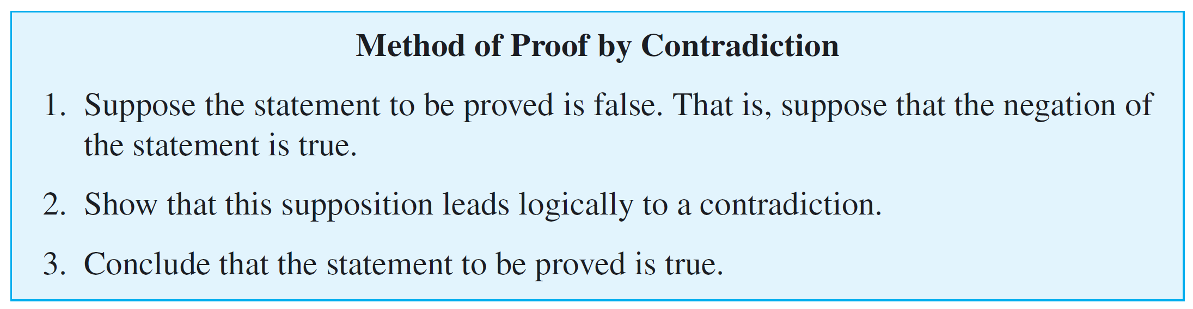
Indirect Argument: Contradiction and Contraposition
The point of departure for a proof by contradiction is the
supposition that the statement to be proved is false. The
goal is to reason to a contradiction. Thus proof by
contradiction has the following outline:

Slide 6
Example 1 – There Is No Greatest Integer
Use proof by contradiction to show that there is no greatest integer.
Solution:
Most small children believe there is a greatest integer—they often call it a “zillion.”
But with age and experience, they change their belief. At some point they realize that if there were a greatest integer, they could add 1 to it to obtain an integer that was greater still.
Since that is a contradiction, no greatest integer can exist. This line of reasoning is the heart of the formal proof.

Slide 7
Example 1 – Solution
cont’d
For the proof, the “certain property” is the property of being the greatest integer. To prove that there is no object with this property, begin by supposing the negation: that there is an object with the property.
Starting Point: Suppose not. Suppose there is a greatest
integer; call it N. This means that N ≥ n for all
integers n.
To Show: This supposition leads logically to a contradiction.

Slide 8
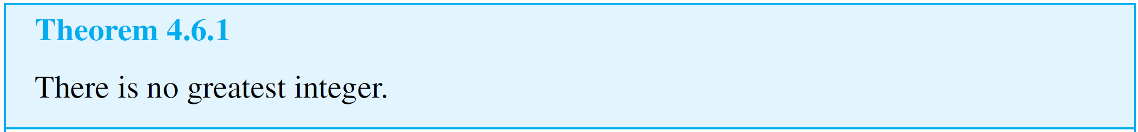
Example 1 – Solution
cont’d
Proof:
[We take the negation of the theorem and suppose it to be true.] Suppose not. That is, suppose there is a greatest integer N. [We must deduce a contradiction.]

Slide 9
Example 1 – Solution
cont’d
Then N ≥ n for every integer n. Let M = N + 1. Now M is an integer since it is a sum of integers. Also M > N since
M = N + 1. Thus M is an integer that is greater than N.
So N is the greatest integer and N is not the greatest integer, which is a contradiction. [This contradiction shows that the supposition is false and, hence, that the theorem is true.]

Slide 10
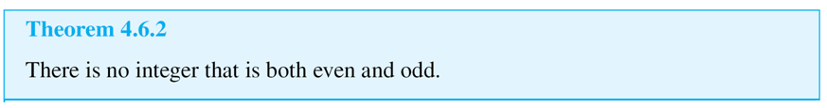
Indirect Argument: Contradiction and Contraposition
The fact that no integer can be both even and odd follows from the uniqueness part of the quotient-remainder theorem.

Slide 11
Argument by Contraposition

Slide 12
Argument by Contraposition
A second form of indirect argument, argument by contraposition, is based on the logical equivalence between a statement and its contrapositive.
To prove a statement by contraposition, you take the contrapositive of the statement, prove the contrapositive by a direct proof, and conclude that the original statement is true.
The underlying reasoning is that since a conditional statement is logically equivalent to its contrapositive, if the contrapositive is true then the statement must also be true.

Slide 13
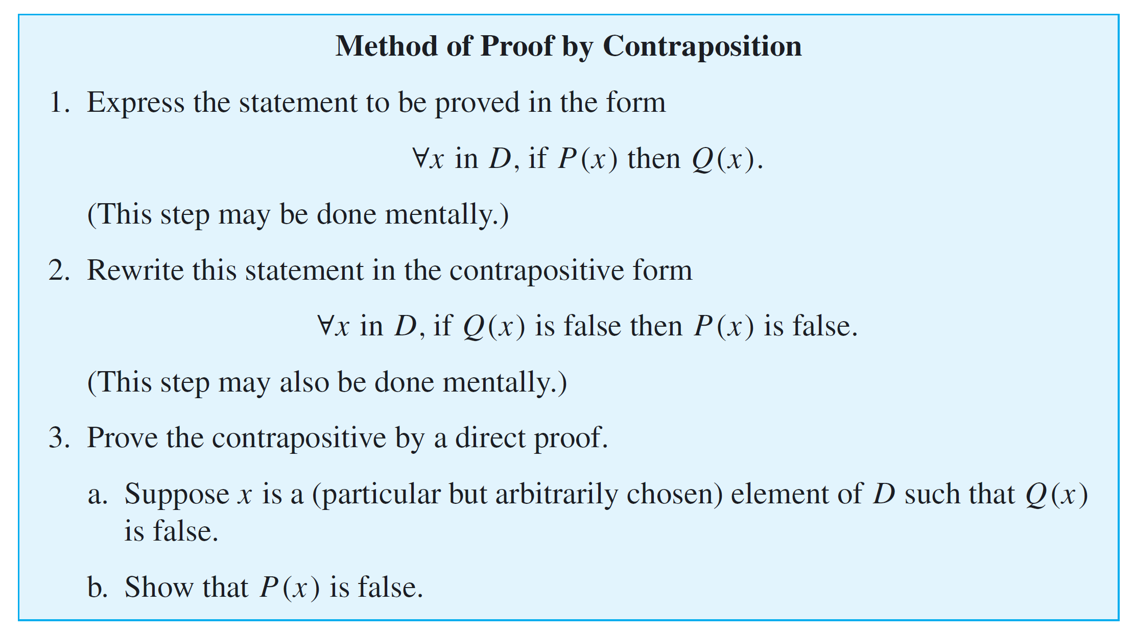
Argument by Contraposition

Slide 14
Example 4 – If the Square of an Integer Is Even, Then the Integer Is Even
Prove that for all integers n, if n² is even then n is even.
Solution:
First form the contrapositive of the statement to be proved.
Contrapositive: For all integers n, if n is not even then n² is not even.
By the quotient-remainder theorem with d = 2, any integer is even or odd, so any integer that is not even is odd. Also by Theorem 4.6.2, no integer can be both even and odd. So if an integer is odd, then it is not even.

Slide 15

Example 4 – Solution
cont’d
Thus the contrapositive can be restated as follows:
Contrapositive: For all integers n, if n is odd then n² is odd.
A straightforward computation is the heart of a direct proof for this statement, which is as follows.

Slide 16
Example 4 – Solution
cont’d
Proof (by contraposition):
Suppose n is any odd integer. [We must show that n² is odd.] By definition of odd, n = 2k + 1 for some integer k. By substitution and algebra,
But 2k² + 2k is an integer because products and sums of integers are integers.
So n² = 2  (an integer) + 1, and thus, by definition of odd, n² is odd [as was to be shown].

Slide 17
Example 4 – Solution
cont’d
We used the word proposition here rather than theorem because although the word theorem can refer to any statement that has been proved, mathematicians often restrict it to especially important statements that have many and varied consequences.
Then they use the word proposition to refer to a statement that is somewhat less consequential but nonetheless worth writing down.

Slide 18
Relation between Proof by Contradiction and Proof by Contraposition

Slide 19

Relation between Proof by Contradiction and Proof by Contraposition
Observe that any proof by contraposition can be recast in the language of proof by contradiction. In a proof by contraposition, the statement
is proved by giving a direct proof of the equivalent statement

Slide 20
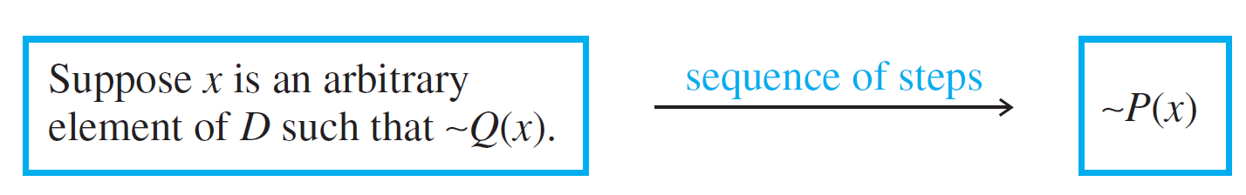
Relation between Proof by Contradiction and Proof by Contraposition
To do this, you suppose you are given an arbitrary element x of D such that ~Q (x). You then show that ~P (x). This is illustrated in Figure 4.6.1.
Exactly the same sequence of steps can be used as the heart of a proof by contradiction for the given statement. The only thing that changes is the context in which the steps are written down.
Proof by Contraposition
Figure 4.6.1

Slide 21
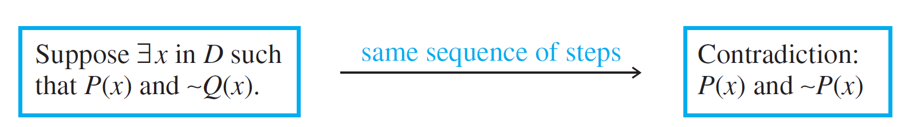
Relation between Proof by Contradiction and Proof by Contraposition
To rewrite the proof as a proof by contradiction, you
suppose there is an x in D such that P (x) and ~Q (x).
You then follow the steps of the proof by contraposition to deduce the statement ~P (x). But ~P (x) is a contradiction to the supposition that P (x) and ~Q (x). (Because to contradict a conjunction of two statements, it is only necessary to contradict one of them.) This process is illustrated in
Figure 4.6.2.
Proof by Contradiction
Figure 4.6.2

Slide 22
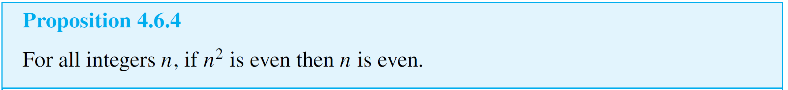
Relation between Proof by Contradiction and Proof by Contraposition
As an example, here is a proof by contradiction of Proposition 4.6.4, namely that for any integer n, if n² is even then n is even.
Proof (by contradiction):
[We take the negation of the theorem and suppose it to be true.] Suppose not. That is, suppose there is an integer n such that n² is even and n is not even. [We must deduce a contradiction.]

Slide 23
Relation between Proof by Contradiction and Proof by Contraposition
By the quotient-remainder theorem with d = 2, any integer is even or odd. Hence, since n is not even it is odd, and thus, by definition of odd, n = 2k + 1 for some integer k. By substitution and algebra:
But 2k² + 2k is an integer because products and sums of integers are integers.
So n² = 2  (an integer) + 1, and thus, by definition of odd, n² is odd. Therefore, n² is both even and odd.

Slide 24
Relation between Proof by Contradiction and Proof by Contraposition
This contradicts Theorem 4.6.2, which states that no integer can be both even and odd.
[This contradiction shows that the supposition is false and, hence, that the proposition is true.]

Slide 25
Relation between Proof by Contradiction and Proof by Contraposition
Note that when you use proof by contraposition, you know exactly what conclusion you need to show, namely the negation of the hypothesis; whereas in proof by contradiction, it may be difficult to know what contradiction to head for.
On the other hand, when you use proof by contradiction, once you have deduced any contradiction whatsoever, you are done.
The main advantage of contraposition over contradiction is that you avoid having to take (possibly incorrectly) the negation of a complicated statement.

Slide 26

Relation between Proof by Contradiction and Proof by Contraposition
The disadvantage of contraposition as compared with contradiction is that you can use contraposition only for a specific class of statements—those that are universal and conditional.
The previous discussion shows that any statement that can be proved by contraposition can be proved by contradiction. But the converse is not true.
Statements such as “ is irrational” can be proved by contradiction but not by contraposition.

Slide 27
Proof as a Problem-Solving Tool

Slide 28
Proof as a Problem-Solving Tool
Direct proof, disproof by counterexample, proof by contradiction, and proof by contraposition are all tools that may be used to help determine whether statements are true or false. Given a statement of the form
For all elements in a domain, if (hypothesis)
then (conclusion),
imagine elements in the domain that satisfy the hypothesis. Ask yourself: Must they satisfy the conclusion?

Slide 29
Proof as a Problem-Solving Tool
If you can see that the answer is “yes” in all cases, then the statement is true and your insight will form the basis for a direct proof.
If after some thought it is not clear that the answer is “yes,” ask yourself whether there are elements of the domain that satisfy the hypothesis and not the conclusion.
If you are successful in finding some, then the statement is false and you have a counterexample. On the other hand, if you are not successful in finding such elements, perhaps none exist.

Slide 30
Proof as a Problem-Solving Tool
Perhaps you can show that assuming the existence of elements in the domain that satisfy the hypothesis and not the conclusion leads logically to a contradiction.
If so, then the given statement is true and you have the basis for a proof by contradiction. Alternatively, you could imagine elements of the domain for which the conclusion is false and ask whether such elements also fail to satisfy the hypothesis.
If the answer in all cases is “yes,” then you have a basis for a proof by contraposition.

